Slide 1


Cloud Computing and Security
BIS613D
Module 5
Cloud Programming and Software Environments
Department of ISE

Slide 2
Programming on Amazon AWS

Slide 3
Programming Support in Amazon AWS
Amazon (like Azure) offers a Relational Database Service (RDS) with a messaging interface
Elastic MapReduce capability is equivalent to Hadoop running on the basic EC2 offering
Amazon has NOSQL support in SimpleDB
Amazon does not directly support BigTable
Amazon offers the Simple Queue Service (SQS) and Simple Notification Service (SNS)

Slide 4
Programming Support in Amazon AWS
Auto-scaling enables you to automatically scale your Amazon EC2 capacity up or down according to conditions that you define
Elastic load balancing automatically distributes incoming application traffic across multiple Amazon EC2 instances
Both auto-scaling and elastic load balancing are enabled by CloudWatch which monitors running instances
CloudWatch is a web service that provides customers with visibility into resource utilization, operational performance, and overall demand patterns
Notes:
With autoscaling, you can ensure that the number of Amazon EC2 instances you’re using scales up seamlessly during demand spikes to maintain performance, and scales down automatically during demand lulls to minimize cost

Slide 5
Programming on Amazon EC2
Amazon was the first company to introduce VMs in application hosting
The elastic feature of such a service is that a customer can create, launch, and terminate server instances as needed, paying by the hour for active servers.
Amazon provides several types of preinstalled VMs. Instances are often called Amazon Machine Images (AMIs) which are preconfigured with operating systems based on Linux or Windows, and additional software.
AMIs are the templates for instances, which are running VMs

Slide 6
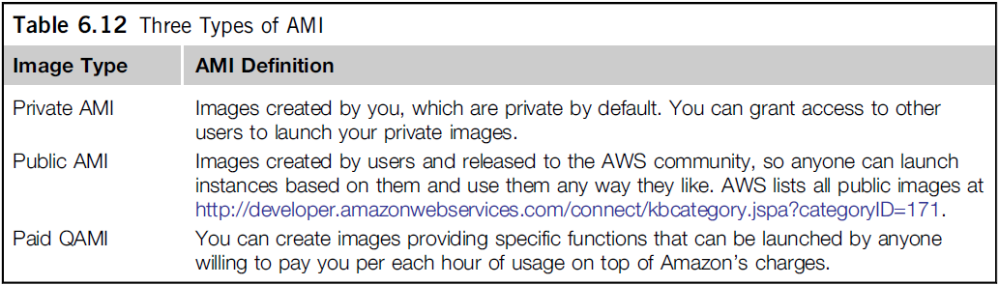
Three Types of AMI

Slide 7
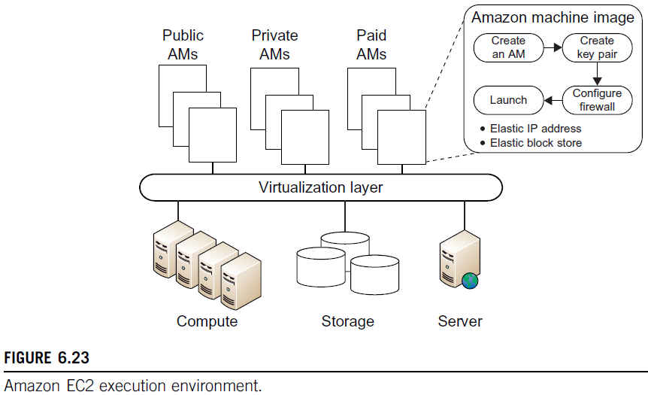
Amazon EC2 Execution Environment

Slide 8
Amazon Simple Storage Service
Amazon S3 provides a simple web services interface that can be used to store and retrieve any amount of data, at any time, from anywhere on the web.
S3 provides the object-oriented storage service for users.
Users can access their objects through Simple Object Access Protocol (SOAP) with either browsers or other client programs which support SOAP.
SQS is responsible for ensuring a reliable message service between two processes, even if the receiver processes are not running

Slide 9
Amazon Simple Storage Service
The fundamental operation unit of S3 is called an object.
Each object is stored in a bucket and retrieved via a unique, developer-assigned key.
In other words, the bucket is the container of the object.
Besides unique key attributes, the object has other attributes such as values, metadata, and access control information.

Slide 10
Amazon Simple Storage Service
From the programmer’s perspective, the storage provided by S3 can be viewed as a very coarse-grained key-value pair.
Through the key-value programming interface, users can write, read, and delete objects containing from 1 byte to 5 gigabytes of data each.
There are two types of web service interface for the user to access the data stored in Amazon clouds – One is a REST (web 2.0) interface, and the other is a SOAP interface

Slide 11
Key Features of Amazon S3 Elastic
Redundant through geographic dispersion
Designed to provide 99.999999999 percent durability and 99.99 percent availability of objects over a given year with cheaper reduced redundancy storage (RRS)
Authentication Mechanisms to ensure that data is kept secure from unauthorized access. Objects can be made private or public, and rights can be granted to specific users.
Per-object URLs and ACLs (Access Control Lists)
Default download protocol of HTTP. A BitTorrent protocol interface is provided to lower costs for high-scale distribution. $0.055 (more than 5,000 TB) to 0.15 per GB per month storage (depending on total amount).
First 1 GB per month input or output free and then $0.08 to $0.15 per GB for transfers outside an S3 region.
There is no data transfer charge for data transferred between Amazon EC2 and Amazon S3 within the same region or for data transferred between the Amazon EC2 Northern Virginia region and the Amazon S3 U.S. Standard region (as of October 6, 2010).

Slide 12
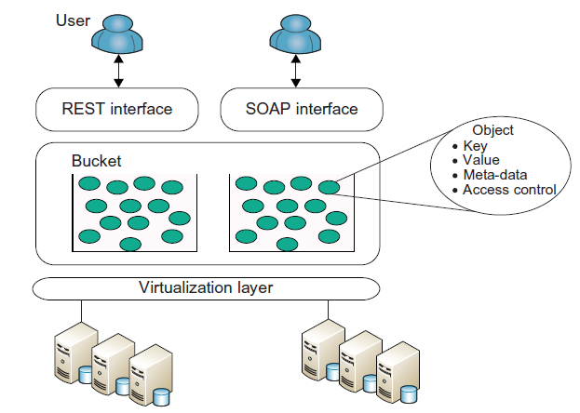
Amazon S3 Execution Environment

Slide 13
Amazon Elastic Block Store (EBS)
Elastic Block Store (EBS) provides the volume block interface for saving and restoring the virtual images of EC2 instances.
Traditional EC2 instances will be destroyed after use.
The status of EC2 can now be saved in the EBS system after the machine is shut down.
Users can use EBS to save persistent data and mount to the running instances of EC2.
Note that S3 is “Storage as a Service” with a messaging interface.
EBS is analogous to a distributed file system accessed by traditional OS disk access mechanisms.
EBS allows you to create storage volumes from 1 GB to 1 TB that can be mounted as EC2 instances.
Multiple volumes can be mounted to the same instance. These storage volumes behave like raw, unformatted block devices, with user-supplied device names and a block device interface.
You can create a file system on top of Amazon EBS volumes, or use them in any other way you would block device (like a hard drive).
Snapshots are provided so that the data can be saved incrementally.
This can improve performance when saving and restoring data

Slide 14
Amazon SimpleDB Service
SimpleDB provides a simplified data model based on the relational database data model.
Structured data from users must be organized into domains.
Each domain can be considered a table.
The items are the rows in the table.
A cell in the table is recognized as the value for a specific attribute (column name) of the corresponding row.
This is similar to a table in a relational database.
However, it is possible to assign multiple values to a single cell in the table.
This is not permitted in a traditional relational database which wants to maintain data consistency.
Many developers simply want to quickly store, access, and query the stored data. SimpleDB removes the requirement to maintain database schemas with strong consistency.

Slide 15
Recollect Quiz
Amazon has ______________ support in SimpleDB
______________ automatically distributes incoming application traffic across multiple Amazon EC2 instances.
______________ was the first company to introduce VMs in application hosting.
The fundamental operation unit of S3 is called an ______________
______________ provides the volume block interface for saving and restoring the virtual images of EC2 instances.
_________provides a simplified data model based on the relational database data model
Notes:
NOSQL
Elastic load balancing
Amazon
Object
Elastic Block Store (EBS)
SimpleDB

Slide 16
THANK YOU

